Slide 1

Web Server Programming Data Integration
Lecturer: Shakhnoza Muksimova

Slide 2
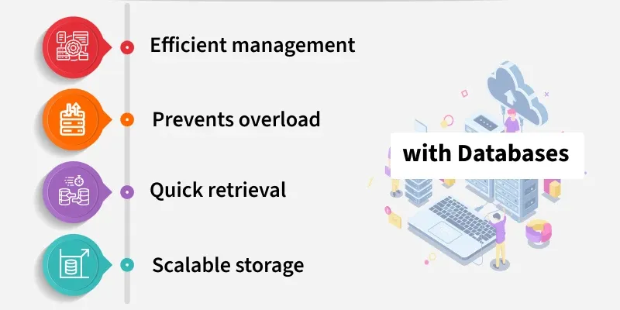
What is a Database?
A Database is a software system which is used to maintain, manage and access an organized collection of data. Just like a traditional library stores books in an organized catalog system, a database stores data in tables or documents, makes it easy to go and find a book and read through it. Rather than manually combing through papers, a database can help find what you need in a matter of seconds.

Slide 3
Role of Database in Web Applications
Databases act as the backbone of any dynamic application in web development. Web application without a database, it will only show static content with no ability to store or fetch user data. Given below is how databases help:
Storing User Data: From personal profiles to preferences, a database stores user-related data.
Content Management: Blogs, products, or articles on websites are managed via databases.
Real-Time Updates: Web applications often require real-time data (like chats or feeds). Databases allow this by constantly updating and fetching data.
User Authentication: Databases store and validate user credentials, such as usernames and passwords.

Slide 4
Why Do Web Developers Need a Database?
Web developers use databases for many reasons:
1. Data Structuring: A database structuring the data in an organized way. With the help of tables, rows and columns, you as a developer can manage complex datasets.
2. Dynamic Content: By storing and returning real-time data, a database turns plain static websites into interactive and dynamic ones.
3. Scalability: Databases make web apps scale by effectively dealing with increased data.
4. Security: Databases provide encryption and access control to safeguard sensitive data like passwords, payment details, and personal information.
5. Data Integrity: Developers just need the right queries and database constraints to keep data accurate and consistent.

Slide 5
Features of Databases
Here are few key benefits that databases are so powerful and essential in terms of web development:
Structured Storage: Data is saved with structure in tables that have rows and columns and predefined data types.
SQL Queries: The Structured Query Language allows you to interact with the database to insert new data, update old data and to get answers to specific questions.
ACID Compliance: Atomicity, Consistency, Isolation and Durability- these are some of the important properties in order to guarantee a reliable transaction in a database.
Data Relationships: In relational databases, you can establish relationships between tables. For instance, you might have users who are associated with orders or comments to posts.
Concurrency Control: Databases help handle multiple users sharing and modifying the data without conflict and at the same time ensuring data integrity.

Slide 6
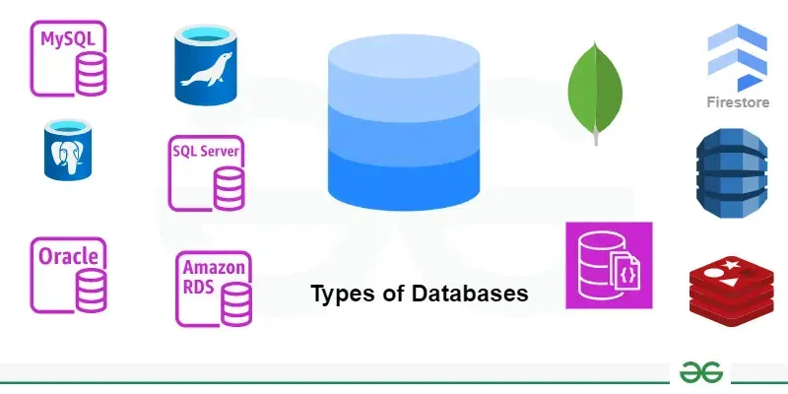
List of Popular Web App Databases
MySQL: It is one of the most widely used relational databases. Great for handling data structures.
PostgreSQL: An advanced, open-source relational database known for its durability and support for complex queries.
MongoDB: It is a NoSQL database that is flexible and perfect for large scale applications with unstructured data
SQLite: A lightweight, serverless relational database that is perfect for small to medium web applications.
Firebase: A cloud-based NoSQL database that allows developers to build real-time applications. It is often used for mobile and web apps with heavy interactivity.
Redis: A key-value store commonly used for caching and session management, helping to speed up web application performance.

Slide 7
How to Connnect your Database to a Web Applications
Here are the steps to connect databases with your Web Applications:
Choose Your Database: First, you need to select a database (relational MySQL or NoSQL , MongoDB database) based on the nature of the app you are building
Set Up the Database: You can install the service on your server or use a cloud service such as Amazon RDS or Google Cloud SQL.
Establishing the Connection: You can establish a connection using a server-side script (PHP, Node. js, or Python) so that your web app can communicate with the database. You will typically be asked to enter the database host, username, password and database name
Perform CRUD Operations: CRUD stands for Create, Read, Update, and Delete. These are the fundamental things you can do to the database: add, view, change, or delete data
Check Your Connection: Test another connection to make sure you can get into the app fast!

Slide 8
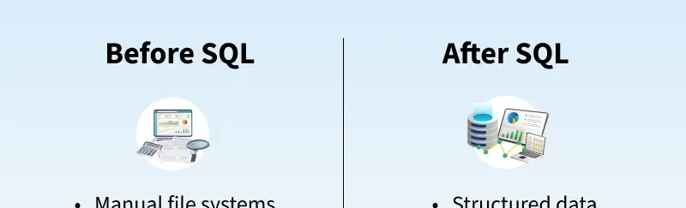
What is SQL?
Structured Query Language (SQL) is the standard language used to interact with relational databases.
It allows users to store, retrieve, update and manage data efficiently through simple commands.
It is known for its user-friendly syntax and powerful capabilities, SQL is widely used across industries.

Slide 9
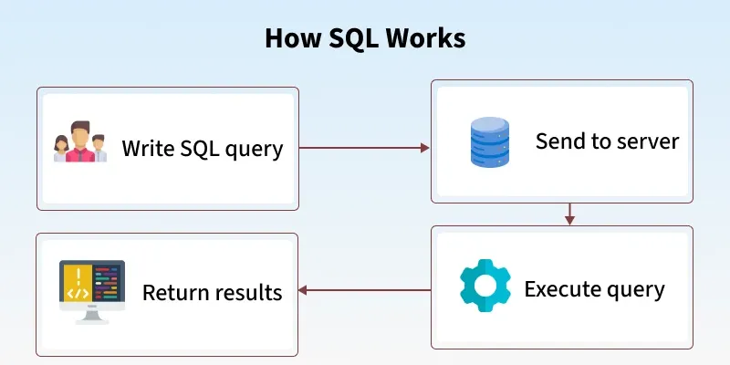
How Does SQL Work?
Below are the detailed steps involved in the SQL query execution.
Input: The user submits a query (e.g., SELECT, INSERT, UPDATE, DELETE) via an application or interface.
Parsing: The query processor breaks the query into parts (tokens) and checks for syntax and schema correctness.
Optimization: The optimizer finds the most efficient way to run the query using indexes, statistics and available resources.
Execution: The execution engine runs the query using the chosen plan, accessing or modifying the database as needed.
Output: Results are returned to the user, either data (for SELECT) or a success message (for other operations).

Slide 10
Key Components of a SQL System
Databases : A database is a structured collection of data. It organizes data into tables, which are like spreadsheets with rows (records) and columns (fields) .
Tables: Each table enforces rules and relationships among its columns for data integrity.
Indexes: Indexes speed up queries by allowing the database to quickly locate data without scanning the entire table.
Views: A view is a virtual table basically a saved SELECT statement you can query like a table.
Stored Procedures: These are pre-written SQL scripts stored inside the database. They can receive inputs, run complex logic and return results boosting performance, reusability and security.
Transactions: A transaction groups multiple SQL operations into a single unit. It ensures all changes are applied successfully or none are, preserving data integrity (ACID properties)
Security and Permissions: SQL includes tools to restrict access, letting DBAs assign who can do what whether it's accessing tables, executing procedures, or changing structures.
Joins: Joins combine data from multiple tables based on relationships essential for querying across related datasets.

Slide 11
Rules for Writing SQL Queries
There are certain rules for SQL which would ensure consistency and functionality across databases. By following these rules, queries will be well formed and well executed in any database.
End with Semicolon (;): Each SQL statement must end with a semicolon to execute properly.
Case Insensitivity: SQL keywords (e.g., SELECT, INSERT) are not case-sensitive. However, table or column names may be case-sensitive depending on the DBMS.
Whitespace Allowed: Queries can span multiple lines, but use spaces between keywords and names.
Reserved Words: Avoid using SQL keywords as names. If needed, wrap them in quotes (" ") or backticks (`).

Slide 12
Comments
Single-line: -- comment
Multi-line: /* comment */
Data Constraints: Use NOT NULL, UNIQUE, PRIMARY KEY, etc., to ensure data accuracy.
String Values: Enclose strings in single quotes ('text').
Naming Rules:
We Start with a letter
We can only use Max 30 characters
We only use letters, numbers and underscores (_)

Slide 13
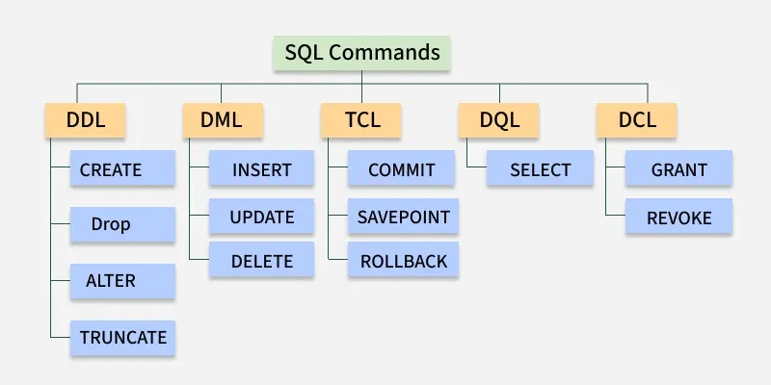
What are Different SQL Commands or Queries?
Structured Query Language (SQL) commands are standardized instructions used by developers to interact with data stored in relational databases. These commands allow for the creation, manipulation, retrieval and control of data, as well as database structures. SQL commands are categorized based on their specific functionalities:

Slide 14
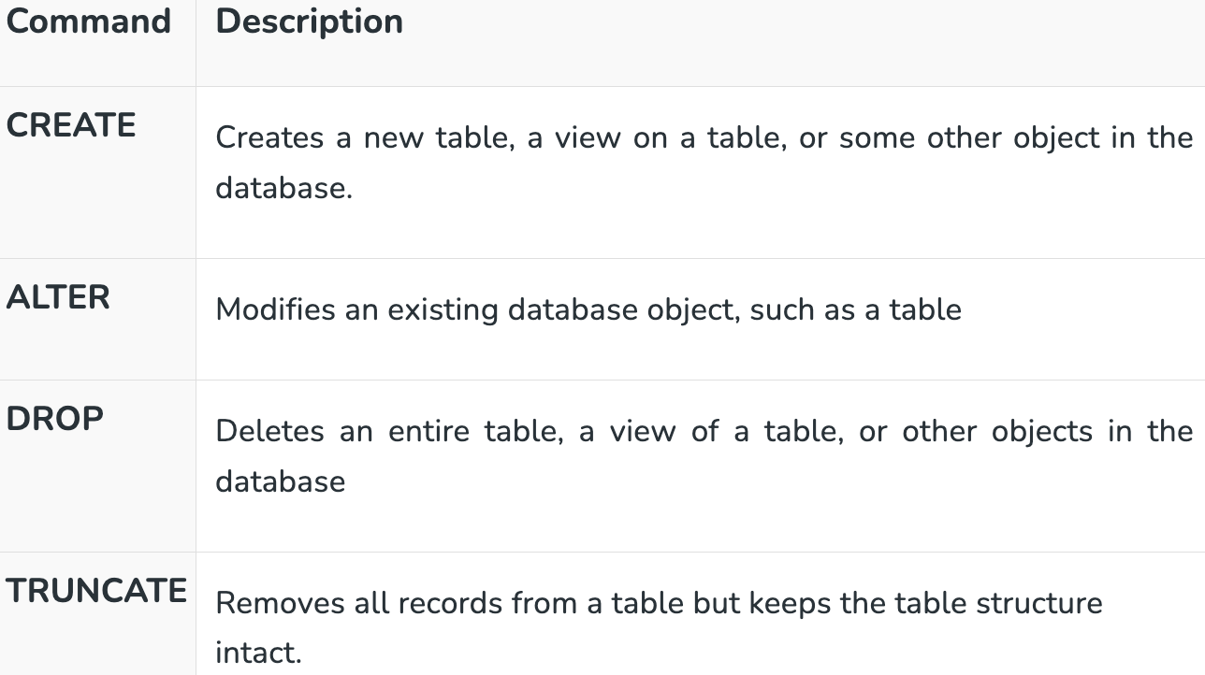
1. Data Definition Language
These commands are used to define the structure of database objects by creating, altering and dropping the database objects. Based on the needs of the business, database engineers create and modify database objects using DDL. The CREATE command, for instance, is used by the database engineer to create database objects like tables, views and indexes.

Slide 15
2. Data Manipulation Language
A relational database can be updated with new data using data manipulation language (DML) statements. The INSERT command, for instance, is used by an application to add a new record to the database.
Command | Description
INSERT | Creates a record.
UPDATE | Modifies records.
DELETE | Deletes records.

Slide 16
3. Data Query Language
Data retrieval instructions are written in the data query language (DQL), which is used to access relational databases. The SELECT command is used by software programs to filter and return particular results from a SQL table.

Slide 17
4. Data Control language
Command | Description
GRANT | Gives a privilege to the user.
REVOKE | Takes back privileges granted by the user.
DCL commands manage user access to the database by granting or revoking permissions. Database administrators use DCL to enforce security and control access to database objects.

Slide 18
5. Transaction Control Language
Command | Description
COMMIT | Saves all changes made during the current transaction on a permanent basis. Some databases provide an auto-commit feature, which can be configured using settings.
ROLLBACK | Reverts changes made during the current transaction, ensuring no unwanted changes are saved.
SAVEPOINT | Sets a point within a transaction to which changes can be rolled back, allowing partial rollbacks
TCL commands manage transactions in relational databases, ensuring data integrity and consistency. These commands are used to commit changes or roll back operations in case of errors.

Slide 19
Benefits of SQL
Efficiency: SQL is designed to handle complex queries and large datasets with optimal performance, making data retrieval and manipulation seamless.
Standardization: As an ANSI and ISO standard language, SQL provides a universal method to interact with relational databases across platforms.
Scalability: SQL supports databases ranging from small-scale applications to enterprise-level systems, ensuring smooth operations regardless of size.
Flexibility: SQL can be extended with procedural programming (PL/SQL, T-SQL) to build complex business logic and custom functions.

Slide 20
Limitations of SQL
Complexity in Advanced Operations: Advanced functionalities such as indexing, query optimization and performance tuning require in-depth technical knowledge.
Scalability Concerns: SQL performs best with structured data but handling unstructured data or massive distributed systems can pose challenges.
Platform-Specific Variations: While SQL is standardized, many databases implement unique extensions, leading to portability and compatibility issues.
Lack of Real Time Analytics: Traditional SQL databases are not optimized for real-time data ingestion and analysis.

Slide 21
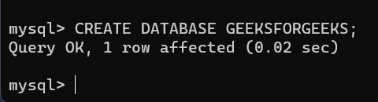
SQL CREATE DATABASE and CREATE TABLE
CREATE command in SQL is used to define new databases and tables. A database acts as a container that holds related objects such as tables, views and procedures, while a table stores data in rows and columns. We will learn how to create databases and tables in SQL with the help of examples.
Creating Database
To create a new database in SQL, we use CREATE DATABASE command followed by the database name. Database names cannot contain spaces; if needed, an underscore (_) can be used instead.
Syntax:
CREATE DATABASE database_name;
Query:
CREATE DATABASE GeeksForGeeks;
Output
Query:
CREATE DATABASE IF NOT EXISTS GeeksForGeeks;

Slide 22
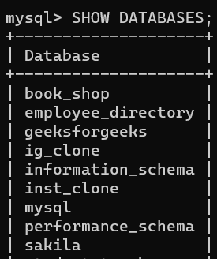
1. Verifying Database Creation
To confirm that a new database has been created, use:
Query:
SHOW DATABASES;
Output

Slide 23
2. Switching to a Database (USE Command)
Once your database is created, we can switch to that database to begin adding tables, inserting data and performing queries. To switch to your new database, use the USE command.
Syntax:
USE database_name
Query:
USE GeeksForGeeks;

Slide 24
3. Deleting a Database
DROP DATABASE GeeksForGeeks;

Slide 25
Creating Tables
A table is the core structure of a database where data is stored in rows and columns. While creating a table, you must define:
Column names
Data types (e.g., INT, VARCHAR, DATE)
Constraints (e.g., PRIMARY KEY, NOT NULL, UNIQUE, DEFAULT, FOREIGN KEY)
Syntax:
CREATE TABLE table_name ( column1 datatype constraint, column2 datatype constraint, ... );

Slide 26
Example: Creating a Student Table
CREATE TABLE Student ( StudentID INT PRIMARY KEY, Name VARCHAR(50) NOT NULL, Subject VARCHAR(50), Year INT, Marks INT );

Slide 27
1. Verifying Table Creation
After running the CREATE TABLE query, the system shows a success message like Table created successfully. To confirm that the table exists, we can list all tables in the current database using:
SHOW TABLES;

Slide 28
2. Deleting a Table
If you no longer need a table, use:
DROP TABLE Student;

Slide 29
How to Install MySQL on Windows?
MySQL is a database engine that provides fast, secure and scalable solutions for both small and large applications. MySQL is known for its reliability, scalability and ease of use, making it a popular choice for web developers and organizations worldwide. By installing MySQL on your Windows machine, you can:
Store and manage data for various types of applications (websites, software, business systems).
Use advanced SQL features for querying, filtering, and modifying data.
Integrate with popular programming languages such as PHP, Python, Java, and Node.js.
Scale your applications seamlessly, handling thousands of transactions and concurrent users.

Slide 30
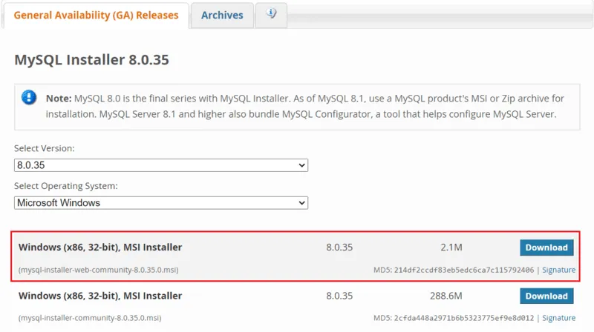
Step 1: Visit the Official MySQL Website

Slide 31
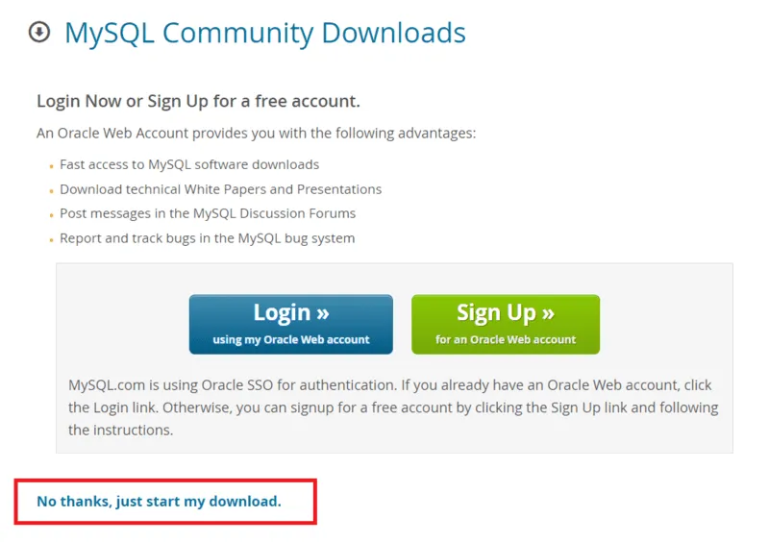
Step 2: Go to the Downloads Section

Slide 32
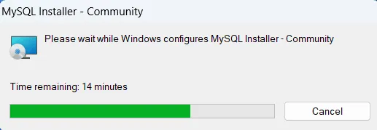
Step 3: Run the Installer

Slide 33
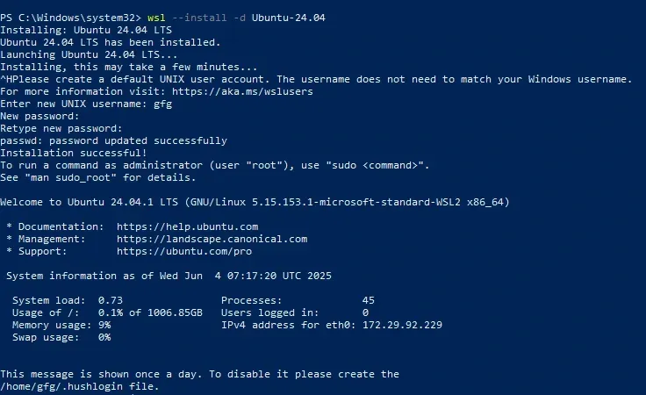
Step 4: Choose Setup Type

Slide 34
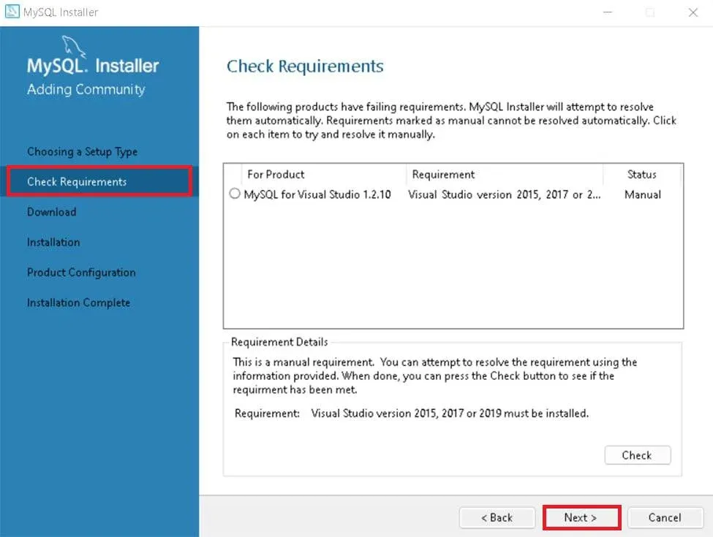
Step 5: Check Requirements

Slide 35
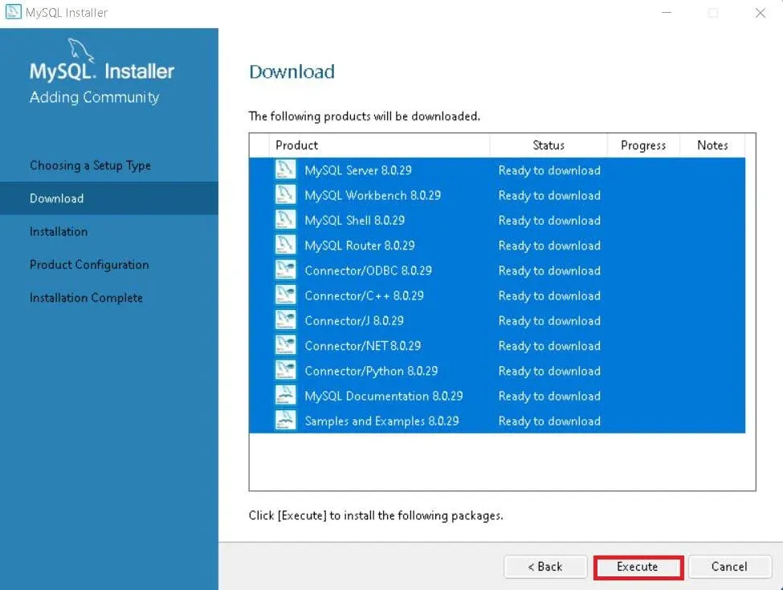
Step 6: MySQL Downloading

Slide 36
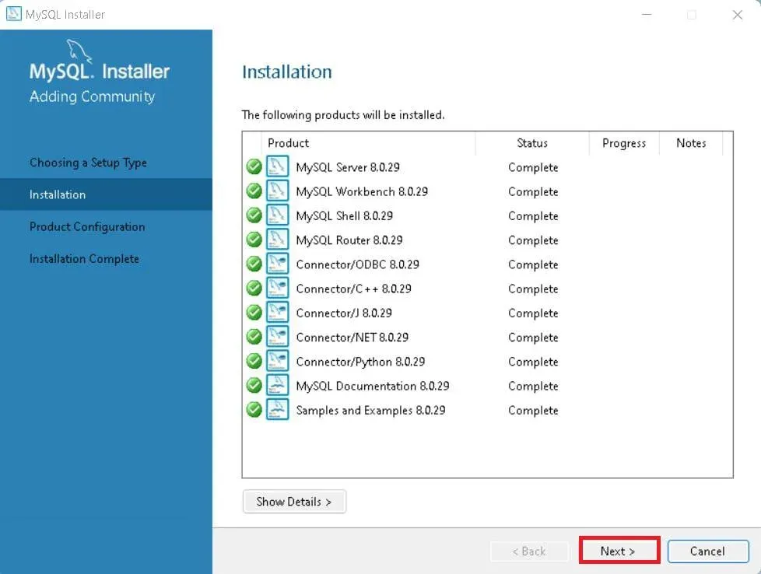
Step 7: MySqL Installation

Slide 37
Step 8: Navigate to Few Configuration Pages
Proceed to "Product Configuration" > "Type and Networking" > "Authentication Method" Pages by clicking the "Next" button.

Slide 38
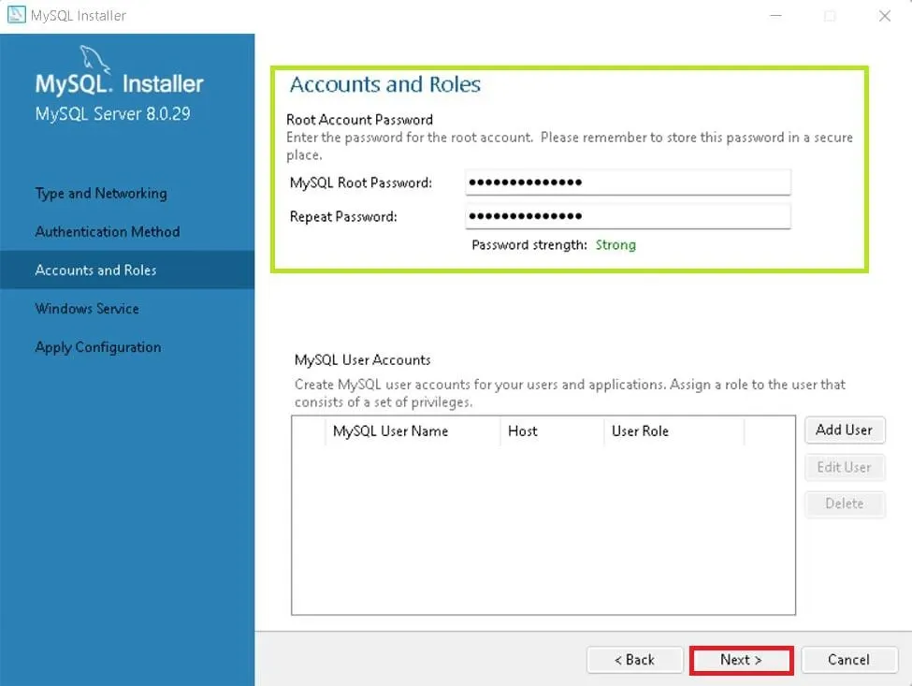
Step 9: Create MySQL Accounts

Slide 39
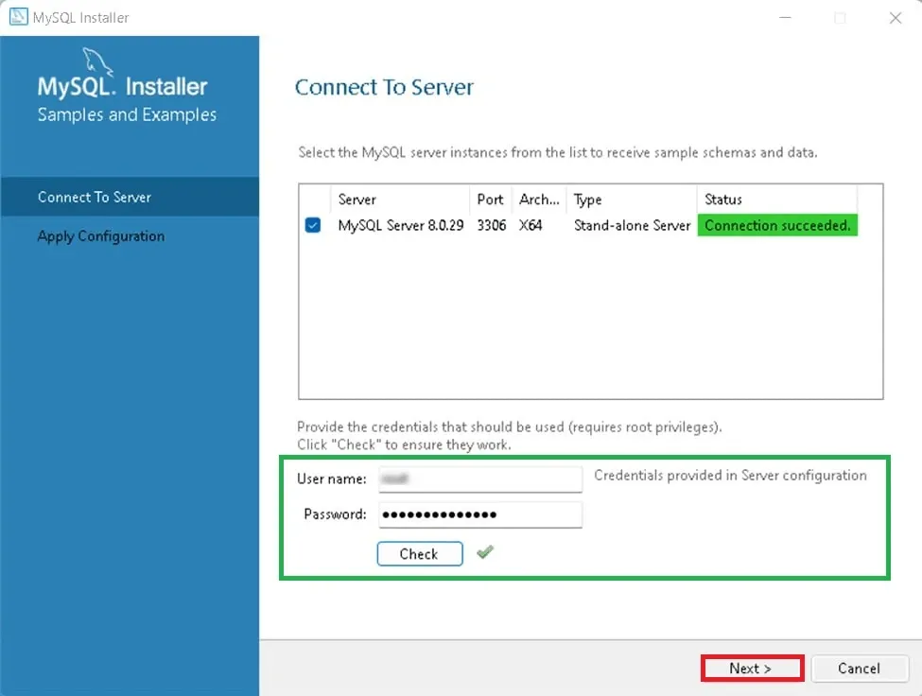
Step 10: Connect To Server

Slide 40
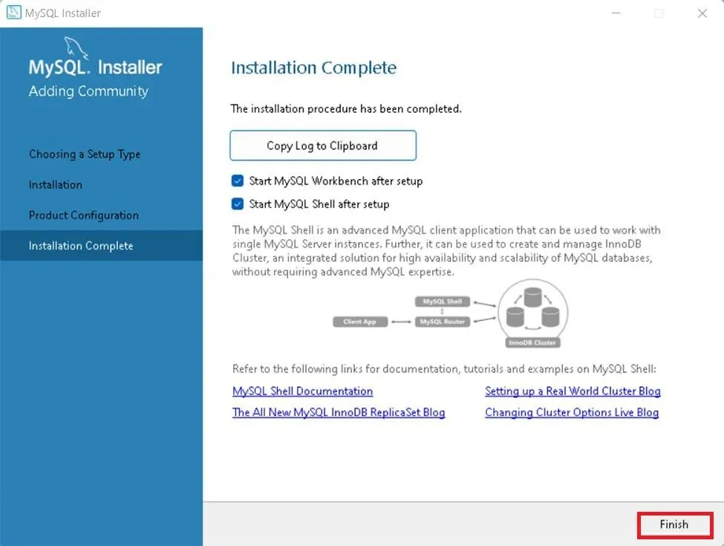
Step 11: Complete Installation

Slide 41
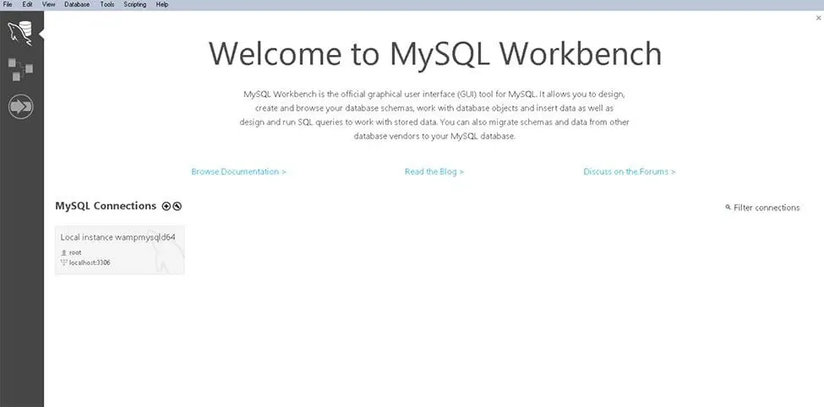
MySQL Workbench Is Ready To Use

Slide 42
Troubleshooting Common MySQL Installation Issues
If you encounter any issues during the MySQL installation process, here are a few common solutions:
Error-Port 3306 is Already in Use: MySQL uses port 3306 by default. If another application is using this port, change the port number during the configuration step.
MySQL Service Fails to Start: Ensure that your Windows firewall is not blocking the MySQL service. Check the Windows Services and verify that the MySQL Server is running.
Invalid Root Password: If you have forgotten your root password, you can reset it by following the appropriate steps from the MySQL documentation.

Slide 43

How to Start & Stop MySQL Server on Windows. 1. With Services.msc
Step 1: Open the Services tab by typing services.msc in the Windows Run dialog.

Slide 44
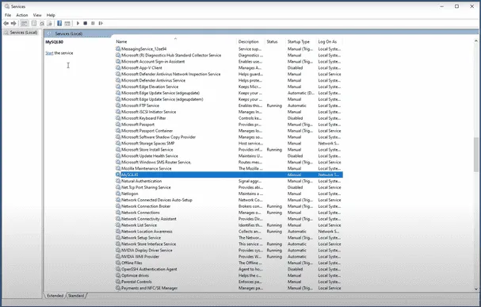
Step 2: Search for the MySQL service in the list.

Slide 45
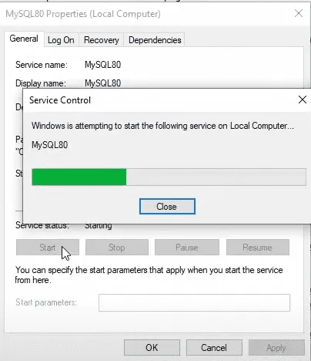
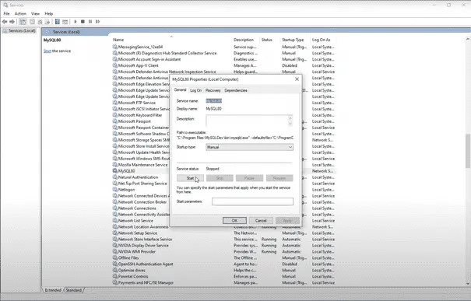
Step 3: Click on the "Start" or "Restart" button to start the MySQL Server

Slide 46
2. Using Command Prompt:
Step 1: Open the Command Prompt.
Step 2: Type the command mysqld and hit Enter.

Slide 47
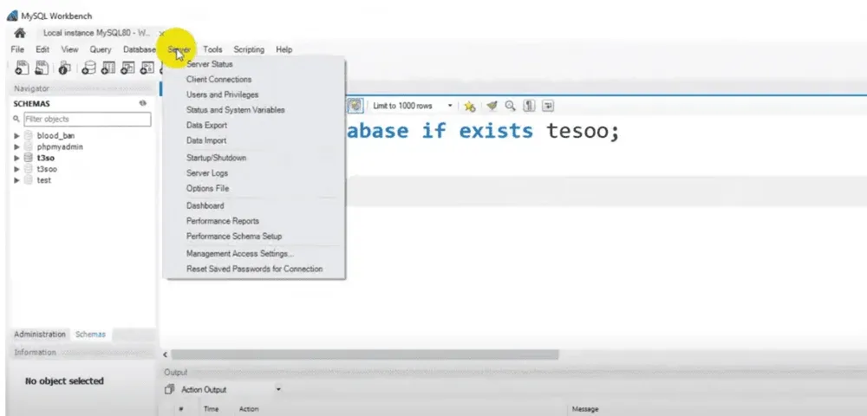
3. Using MySQL Workbench:
Step 1: Open MySQL Workbench, which is included in the MySQL complete package. Go to the top menu bar and click on Server.

Slide 48
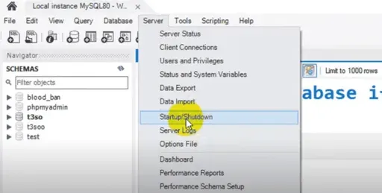
Step 2: Now Navigate to the "Startup/Shutdown" tab in the list

Slide 49
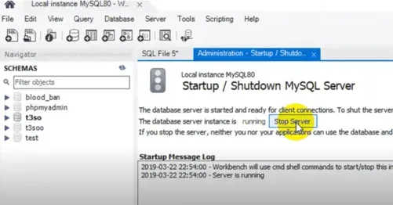
Step 3: In the window that appears, click Start Server if it's not already running.

Slide 50
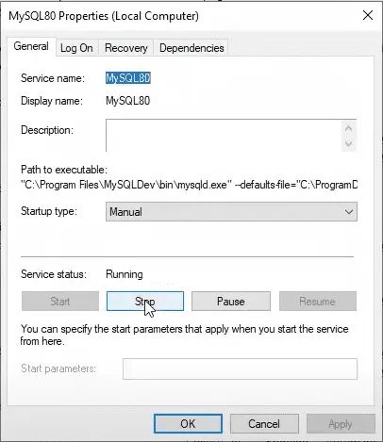
Stopping the Server
1. Using services.msc:
You can stop the MySQL service the same way you started it, by accessing the Services tab and clicking "Stop."

Slide 51
2. Using mysqladmin:
Execute the following command in the Command Prompt:
mysqladmin -u <username> shutdown

Slide 52
3. Using MySQL Workbench:
Go to the "Startup/Shutdown" tab under the Administration section in MySQL Workbench and click "Stop" to shut down the server.

Slide 53
How to Install MongoDB on Windows?
Installing MongoDB on Windows involves downloading the official MongoDB installer, running it to set up the server, and configuring it to run as a Windows service. Once installed, you can use the MongoDB shell or Compass GUI to interact with your databases. This process ensures MongoDB is ready for development or production use on a Windows system.

Slide 54
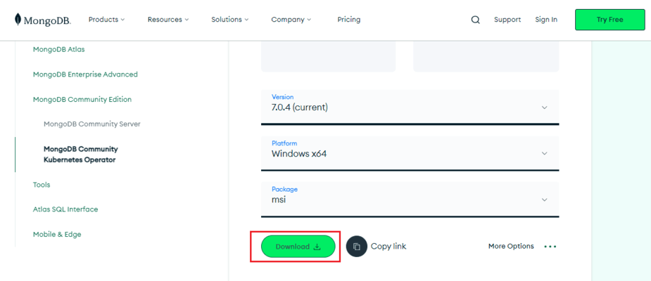
How to Install MongoDB on Windows Using MSI
Step 1: Download MongoDB Community Server

Slide 55
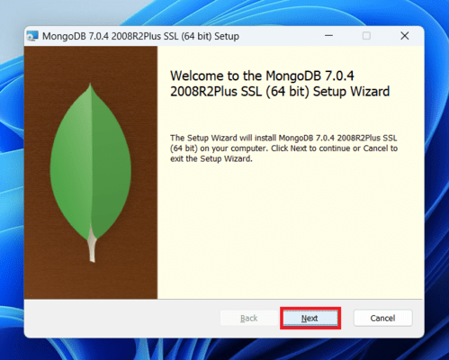
Step 2: Install MongoDB

Slide 56
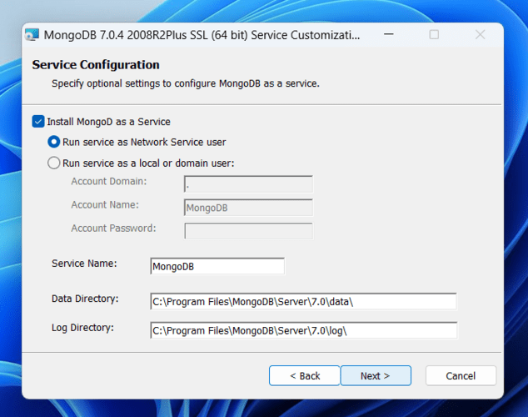

Slide 57
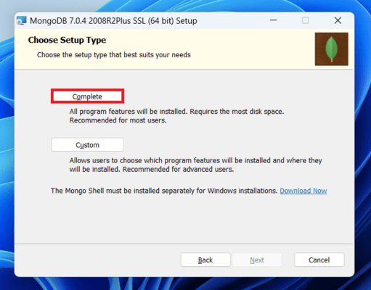

Slide 58
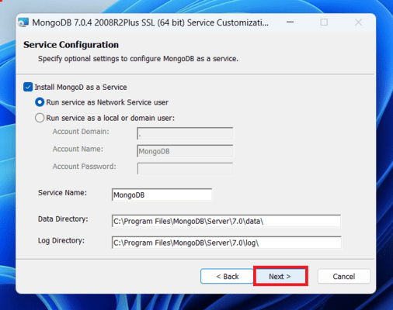
Step 3: Configure MongoDB Service

Slide 59
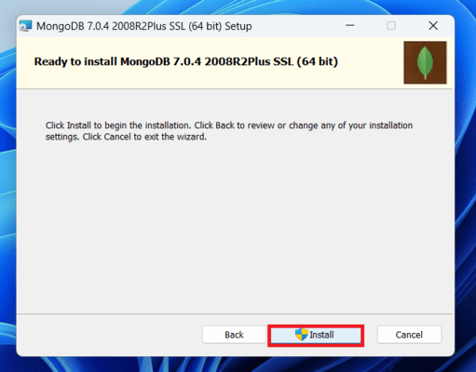
Notes:
Click the Install button to start the MongoDB installation process:

Slide 60
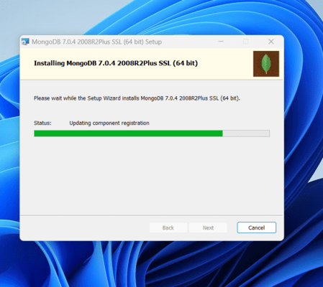
Notes:
After clicking on the install button installation of MongoDB begins:
Step 4: Complete Installation
Now click the Finish button to complete the MongoDB installation process:

Slide 61
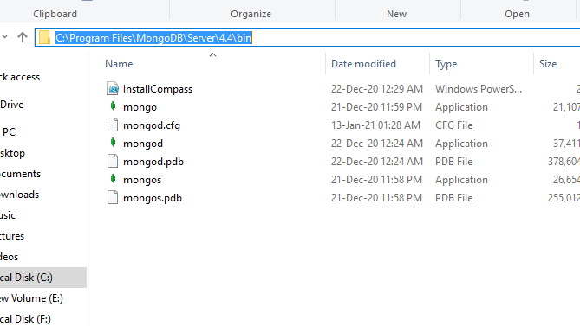
Step 5: Set Environment Variables
Notes:
Now we go to the location where MongoDB installed in step 5 in your system and copy the bin path:

Slide 62
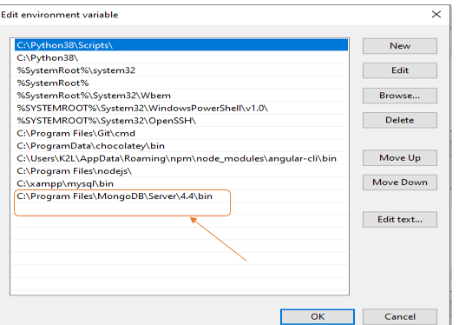

Slide 63
Run MongoDB Server (mongod)
To run the MongoDB server (mongod) on Windows, follow these steps: Step 1. Start MongoDB Service
After setting the environment variable, we will run the MongoDB server, i.e. mongod.
So, open the command prompt and run the following command:
mongod
When you run this command you will get an error i.e. C:/data/db/ not found.

Slide 64
Step 2. Create Required Folders
Now, Open C drive and create a folder named "data"
Inside the data folder create another folder named "db".

Slide 65
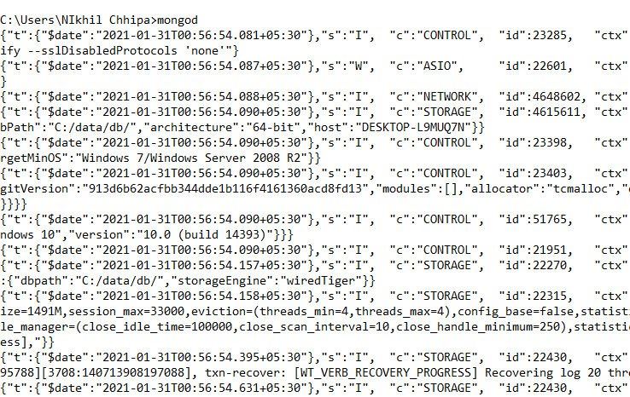
Step 3. Restart MongoDB
After creating these folders. Again open the command prompt and run the following command:
mongod

